Slide 1
Data Science Job Salaries
Providing insights into salary trends across different countries, experience levels, and employment types using Tableau
Shreya Singh Chauhan | Unified Mentor | 10 August
Project Link:- Tableau Dashboard

Slide 2
Understanding The Problem
The Data Science industry is booming, but salaries vary greatly by role, region, and experience.
Lack of clear, consolidated salary benchmarks causes uncertainty for job seekers and employers.
Goal: Analyze global salary trends to identify key factors influencing pay.
Outcome: Provide insights to help professionals and organizations make informed decisions.

Slide 3
Project Objectives
To explore and visualize global Data Science salary trends.
Identify the impact of factors like country, experience, job title, and employment type on pay.
Deliver actionable insights for career planning and hiring strategies.

Slide 4
Dataset Descriptions
Source: Public dataset on Data Science job salaries from various global job postings.
Rows: 607 job records.
Purpose: Used to identify and analyze salary trends in the Data Science field.
Columns: 11 features including:

Slide 5
Techniques – Data Preparation and Data Cleaning in Tableau
Data Cleaning
Removed missing and duplicate records.
Standardized country codes to full names for readability.
Converted salary to consistent currency (USD).
Data Preparation
Created calculated fields (e.g., Salary in USD).
Grouped job titles into broader categories for analysis.
Encoded categorical variables for comparison.

Slide 6
Techniques Used- Data Visualization
Data Visualization
Used Tableau for interactive dashboards.
Bar charts, maps, and scatter plots for trend analysis.
Filters for year, job title, and experience level.

Slide 7
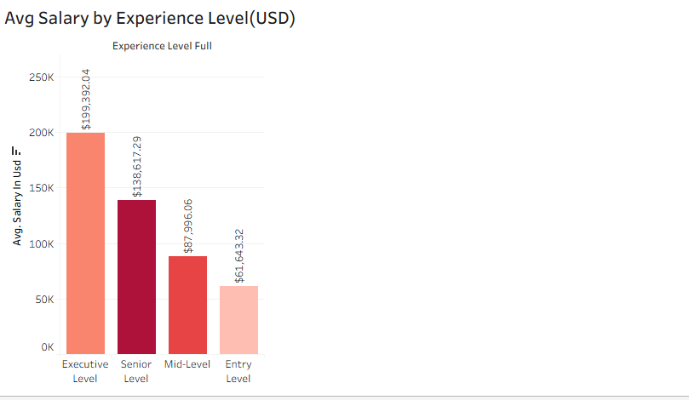
Average Salary by Experience Level(USD)

Slide 8
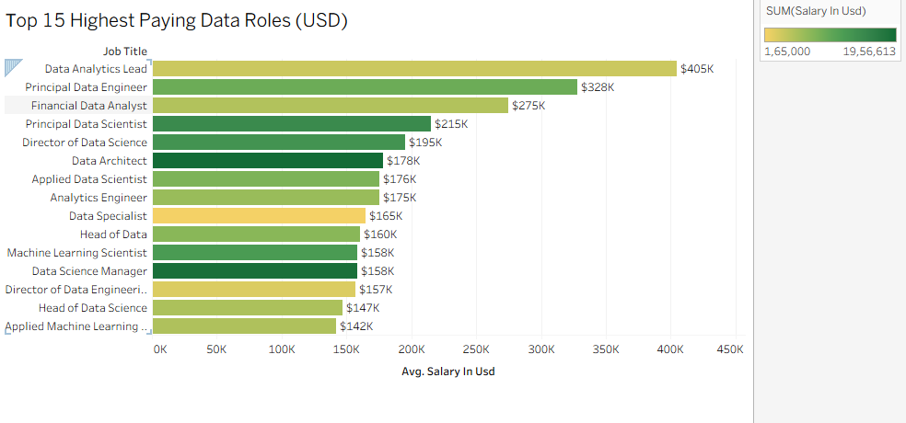
Top 15 Highest Paying Job Titles

Slide 9
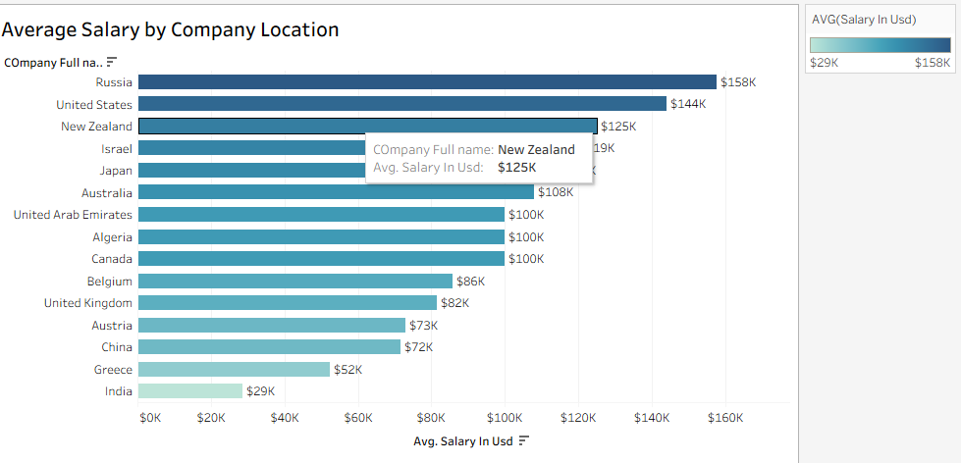
Average Salary by Company Location

Slide 10
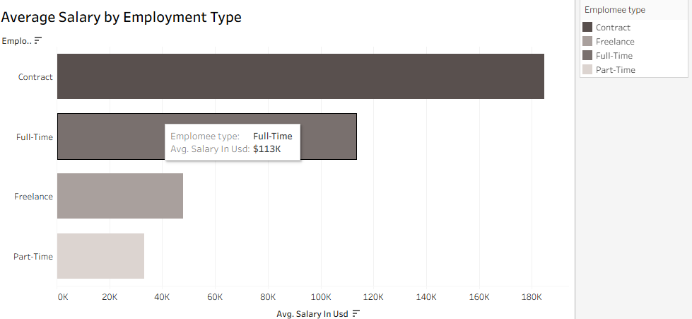
Average Salary by Employment Type

Slide 11
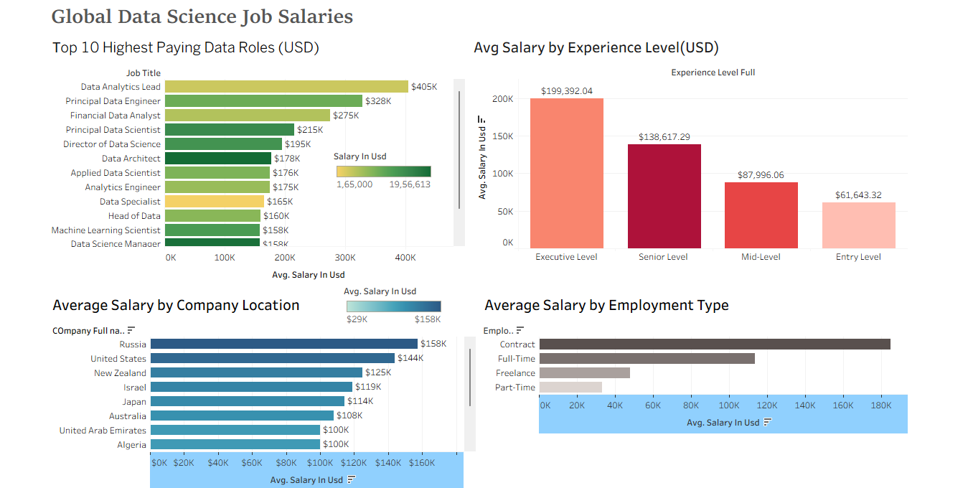
Final Dashboard Output

